Slide 1
Shoppit
social • local • shopping
Alex Kaganovich & Eliezer Steinbock

Slide 2
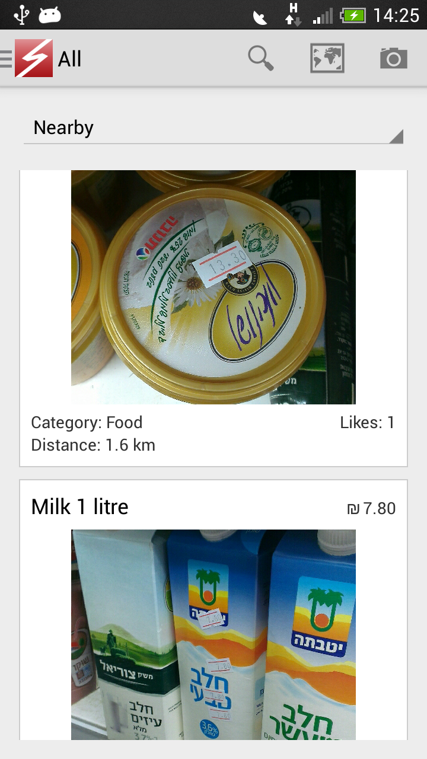
Shoppit uses the power of crowdsourcing to find items at nearby stores.

Slide 3
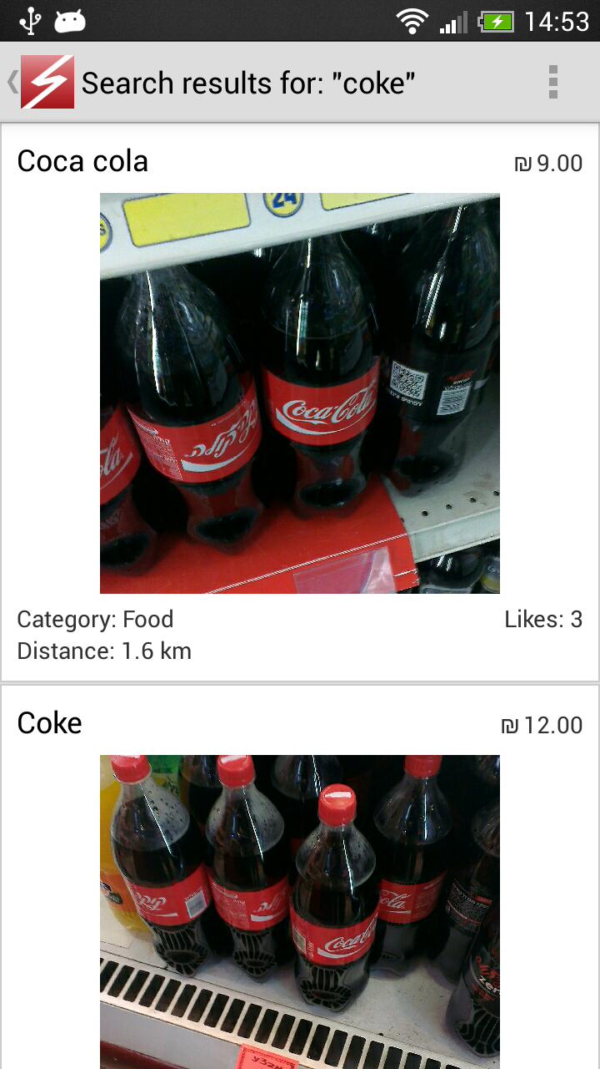
Find what you need. Cheap and nearby.

Slide 4
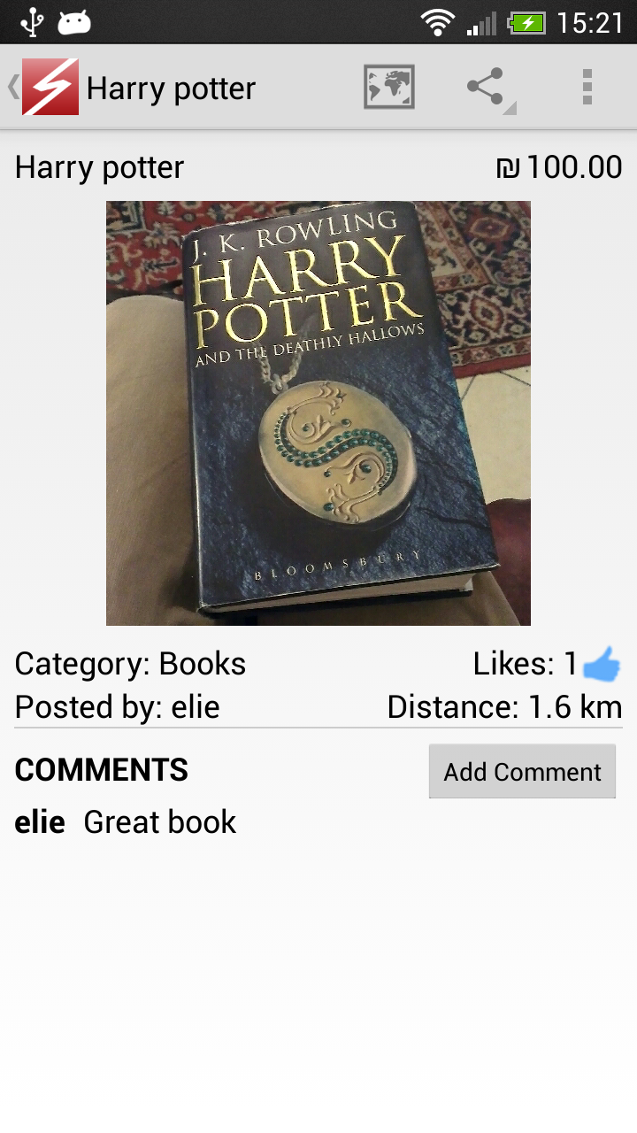
Upload items and share with friends.

Slide 5

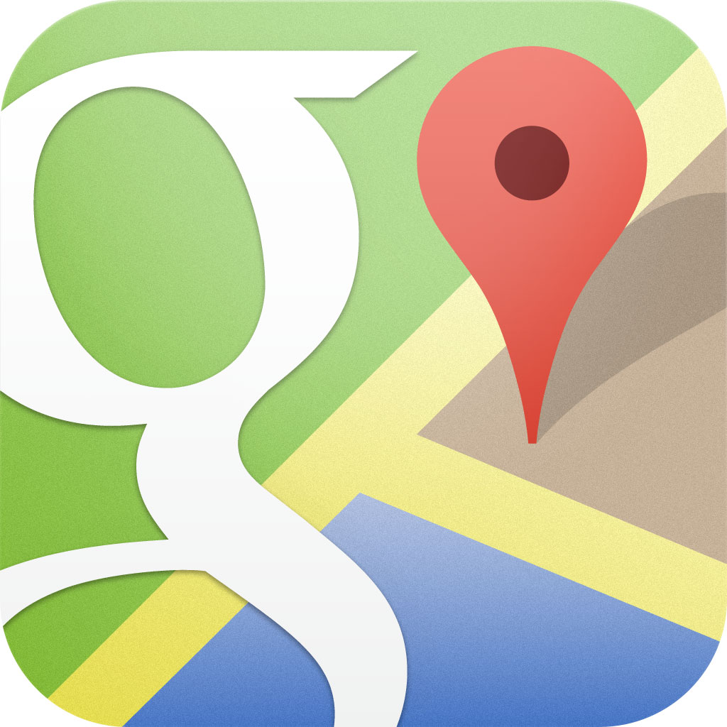

Architecture
zxing barcode scanning
Parse
Google Maps

Slide 6
Thank you

